Slide 1
Filtering: smoothing and sharpening

Slide 2
Filtering: smoothing
Smoothing filters help to discover important slowly-varying patterns in the signal while leaving out fast-varying, local, and often unimportant features
The goal of smoothing is to produce slow changes to see trends in our data:
the individual points higher/lower than the adjacent points (presumably because of noise) are reduced/increased
In most smoothing algorithms:
a group of adjacent points in the original data are multiplied point-by-point by a set of numbers (coefficients)
the sum of the coefficients is normalized (i.e. their sum is 1) in order to preserve the power of the signal
Notes:
When the important information is in the “slow” pattern, smoothing filters produce a signal with “slow changes” in value so that It is easier to see these trends.

Slide 3
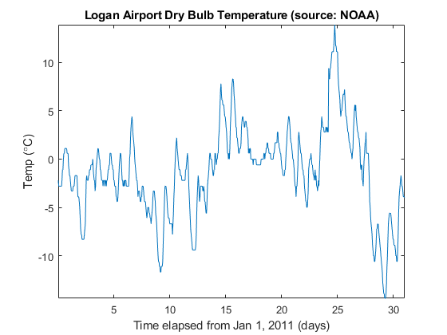
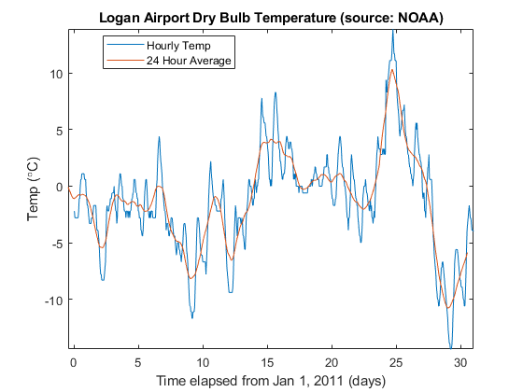

Filtering: smoothing
The simplest smoothing algorithm is the moving average filter
it simply replaces each point in the signal with the average of N adjacent points, also called smooth window:
$$y(t)=\frac{1}{N}\left(x\left(t−a\right)+…+x\left(t\right)+…+x\left(t+b\right)\right)$$
Notes:
The moving average filter simply replaces each point in the signal with the average of N adjacent points

Slide 4
Filtering: sharpening
Sharpening filters tries to emphasize the details of the signal, emphasizing the differences across neighboring samples
They are the opposite of the smoothing filters counterpart
Sharpening filters leverage on derivative filters, emphasizing the difference between samples
Notes:
Sharpening filters tries to emphasize the details of the signal. A very simple method is the unsharp masking.

Slide 5
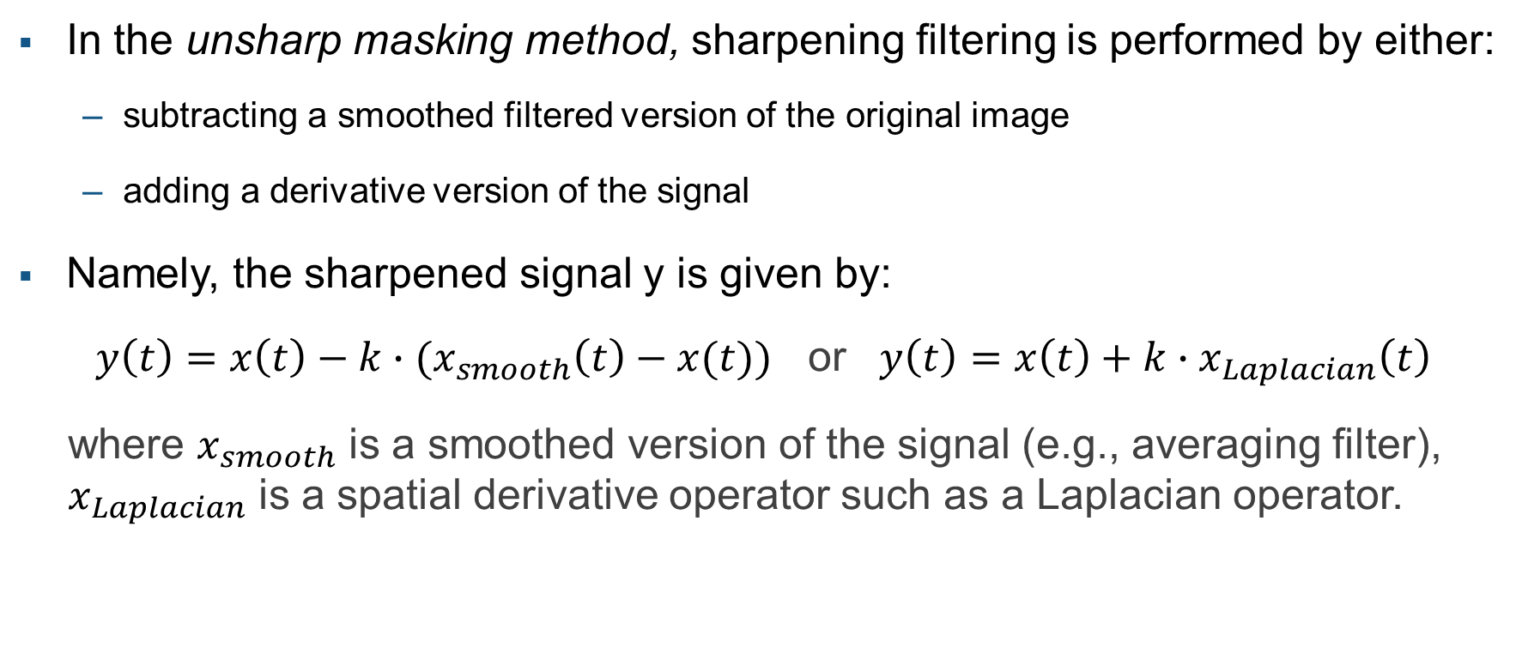
Filtering: unsharp masking method
In the unsharp masking method, sharpening filtering is performed by either:
subtracting a smoothed filtered version of the original image
adding a derivative version of the signal
Namely, the sharpened signal y is given by:
$y\left(t\right)=x\left(t\right)−k∙{(x}_{smooth}\left(t\right)−x(t))$ or $y\left(t\right)=x\left(t\right)+k∙x_{Laplacian}\left(t\right)$
where $x_{smooth}$ is a smoothed version of the signal (e.g., averaging filter), $x_{Laplacian}$ is a spatial derivative operator such as a Laplacian operator.
Notes:
The unsharp masking method could be performed in two ways:
subtracting a smoothed filtered version of the original image
adding a derivative version of the signal
Since we have already seen the smoothing filters, it is easy to understand the first way.
In the .mlx example, through experiments, it will be easier to see the effect of this sharpening filter

